Slide 1

Colonial Heights
City Council Regular Meeting
October 11, 2022

Slide 2

Colonial Heights City Council Meeting October 11, 2022
Call to Order
Roll Call
Devotion – The Honorable T. Gregory Kochuba
Pledge of Allegiance
Adoption of Agenda
Declarations of Personal Interest

Slide 3
Colonial Heights City Council Meeting October 11, 2022
Commendations And Presentations:
A. Presentation Of The City's 2022 Annual Donation To The Chesterfield/Colonial Heights Christmas Mother, Bonnie Cauthorn.

Slide 4
Colonial Heights City Council Meeting October 11, 2022
Commendations And Presentations:
B. Recognition Of Lieutenant James Stacey Whitt As The Recipient Of The 2022 Virginia Association Of Chiefs Of Police Award For Valor

Slide 5
Colonial Heights City Council Meeting October 11, 2022
Commendations And Presentations:
C. Recognizing Maxie Brown For Her Exemplary Service As Interim Planning Director

Slide 6
Colonial Heights City Council Meeting October 11, 2022
Commendations And Presentations:
D. Recognizing Rebecca Griffin For Her Exemplary Service As Interim Finance Director

Slide 7
Colonial Heights City Council Meeting October 11, 2022
Commendations And Presentations:
E. Recognition Of The Office On Youth Summer 2022 Leadership Programs

Slide 8
Office On Youth & Human Services
2022 Summer

Slide 9
OOY Leadership Programs
Youth Advisory Council
Summer Youth Leadership program
A youth led organization that offers the youth of Colonial Heights an opportunity to create and participate in meaningful community level change as well as provide a space for the engagement of healthy and safe activities for youth.
Members are from the grades 6th to 12th grade
Office on Youth provides a summer leadership program for rising 6th and 7th graders.
The program aims to teach youth about leadership and be introduced to leadership in our city.
Our young leaders also work on a joint project with our Youth Advisory Council.

Slide 10
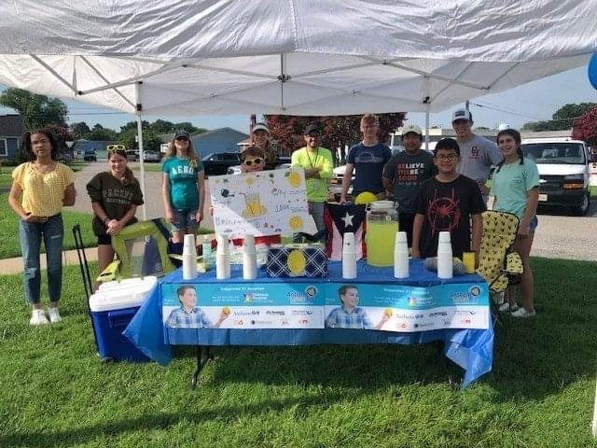
Summer Youth Leadership & LifeSkills program
The Leadership group along with the Youth Advisory council sponsored a Lemon-Aid stand to raise money for Richmond’s Children’s Hospital.
The goal was to raise $300.00 and we raised…

Slide 11



Summer Youth Leadership & LifeSkills program
$611.33!!!

Slide 12
RVA The Basics are…
YAC and the Youth Leadership program also assisted our office in completing and delivering kits for each of the preschool classrooms in our elementary schools.
The Basics movement aims to help every family help every child reach their full potential.
The kits were put together following the five basics which are:
Maximize Love, Manage Stress
Count, Group, and Compare
Talk, Sing, and Point
Explore through Movement and Play
Read and Discuss Stories

Slide 13
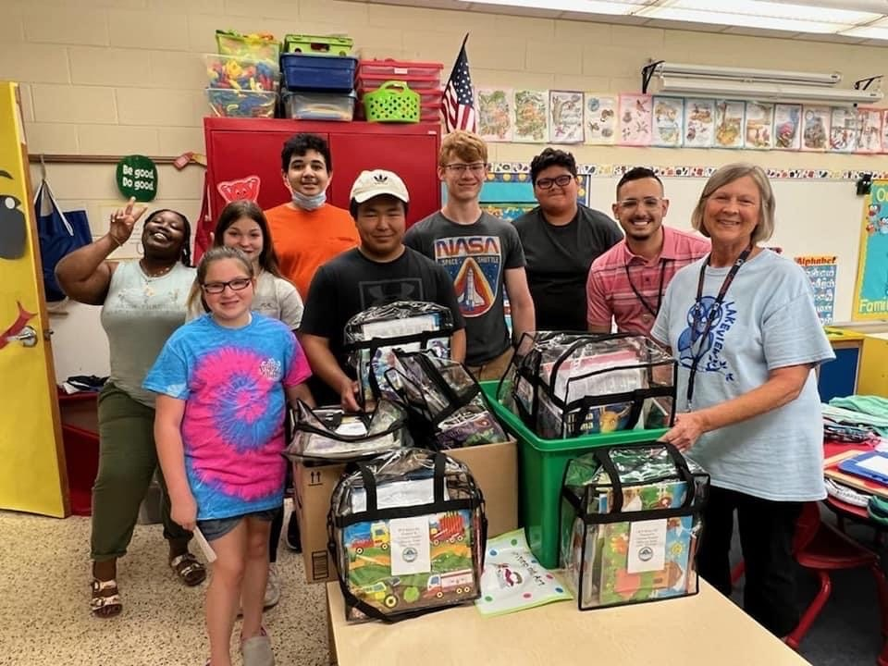
Lakeview Elementary
Delivering RVA Kits to Betty Brooks, Lakeview’s Preschool teacher!

Slide 14
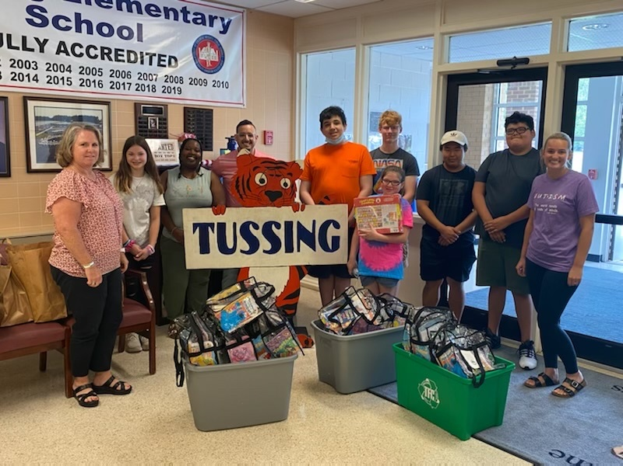
Tussing Elementary
Delivering RVA Kits to Emily Bartholomew and Alison Smith, Tussing Elementary’ s Preschool teachers.

Slide 15
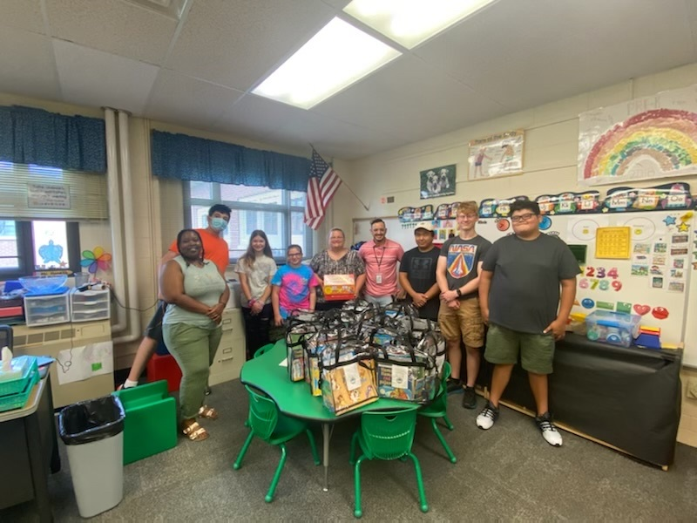
North Elementary
Delivering RVA Kits to Jamie Warf North’s Preschool teacher.

Slide 16
Colonial Heights City Council Meeting October 11, 2022
8. Reading of Manner Addressing Council
ANY MEMBER OF THE PUBLIC addressing the Council shall approach the lectern, give his name and address in an audible tone of voice for the record, AND ADDRESS THE COUNCIL AS A BODY RATHER THAN SPEAK TO ANY MEMBER. Unless further time is granted by the Council, ANY MEMBER OF THE PUBLIC shall address the Council for a maximum of five (5) minutes, regardless of the number of issues he desires to discuss. PROVIDED however, that the main proponent of any application, petition, or plan that is the subject of a public hearing shall be allowed to address the Council initially for a
maximum of ten (10) minutes and later in rebuttal for a maximum of three (3) minutes.

Slide 17
Colonial Heights City Council Meeting October 11, 2022
9. Written Petitions and Communications By Members of the Public and Council Members
None

Slide 18
Colonial Heights City Council Meeting October 11, 2022
10. Advertised Public Hearings
None

Slide 19
Colonial Heights City Council Meeting October 11, 2022
11. Hearing of Citizens Generally on Non-Agenda Items

Slide 20
Colonial Heights City Council Meeting October 11, 2022
12. Consideration of Uncontested Minutes, Ordinances, Resolutions, and Motions in Accordance with the Consent Agenda
A. AN ORDINANCE NO 22-17
(Second Reading) Approving the City’s Membership in the Virginia’s Gateway Region Industrial Facilities Authority.

Slide 21
Colonial Heights City Council Meeting October 11, 2022
12. Consideration of Uncontested Minutes, Ordinances, Resolutions, and Motions in Accordance with the Consent Agenda
B. AN ORDINANCE NO 22-FIN-11
(Second Reading) To amend the General Fund Budget for the fiscal year beginning July 1, 2022 and ending June 30, 2023, by $815,450 consisting of: 1) a $11,508 payment from the National Opioid Settlement, 2) $8,030 from asset forfeiture funds to replace outdated physical fitness equipment, and 3) $795,912 in prior year encumbrances.
To amend the Recreation Fund Budget for the fiscal year beginning July 1, 2022 and ending June 30, 2023, by appropriating $3,364 in prior year encumbrances.
To amend the Stormwater Fund Budget for the fiscal year beginning July 1, 2022 and ending June 30, 2023, by appropriating $8,037 in prior year encumbrances.
To amend the Water and Sewer Fund Budget for the fiscal year beginning July 1, 2022 and ending June 30, 2023, by appropriating $41,311 in prior year encumbrances.
To amend the Emergency Response Fund Budget for the fiscal year beginning July 1, 2022 and ending June 30, 2023, by appropriating $75,620 in prior year encumbrances.

Slide 22
Colonial Heights City Council Meeting October 11, 2022
12. Consideration of Uncontested Minutes, Ordinances, Resolutions, and Motions in Accordance with the Consent Agenda
C. June 14th, 2022 Regular Meeting Minutes
D. June 21st, 2022 Special Meeting Minutes
E. July 12th, 2022 Special Meeting Minutes
F. September 13th, 2022 Special Meeting Minutes

Slide 23
Colonial Heights City Council Meeting October 11, 2022
13. Introduction And Consideration Of Ordinances And Resolutions:
A. A RESOLUTION NO 22-45
Approving participation in the Virginia Juvenile Community Crime Control Act plan.

Slide 24
Colonial Heights City Council Meeting October 11, 2022
13. Introduction And Consideration Of Ordinances And Resolutions:
B. A RESOLUTION NO 22-46
Requesting the Commonwealth Transportation Board to establish a project in the City of Colonial Heights; and to enter into a Project Administration Agreement with the Virginia Department of Transportation for UPC 121680 Route 1 State of Good Repair Project.

Slide 25
Colonial Heights City Council Meeting October 11, 2022
14. Unfinished Business, Contested Ordinances And Resolutions, And Items Removed From The Consent Agenda
None

Slide 26
Colonial Heights City Council Meeting October 11, 2022
Reports of Officers and Documents Related Thereto:
A. City Manager
1. General Activity Report

Slide 27
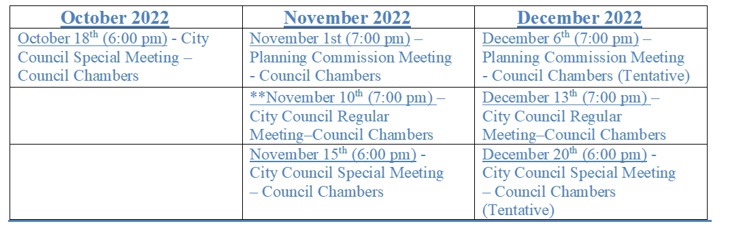
Dates of Interest
**Regular Meeting held on Thursday due to Election Day on Tuesday, Nov. 8th, 2022.

Slide 28
CITY HOLIDAYS
Friday, November 11, 2022– (Government Offices Closed)
Thursday, November 24 & Friday, November 25, 2022– (Government Offices Closed)
Friday, December 23 & Monday, December 26, 2022 – (Government Offices Closed)
Monday, January 2, 2023 – (Government Offices Closed)
CITY ACTIVITIES/EVENTS
Halloween in the Park: Monday, October 31st from 6-8pm at Flora Hill Park (Games, Music, Free Candy)
General & Special Elections: Tuesday, November 8, 2022 (City Council and School Board Elections)
69th Annual Christmas Parade: Tuesday, December 6, 2022 at 7:00pm.

Slide 29
Colonial Heights City Council Meeting October 11, 2022
Reports of Officers and Documents Related Thereto cont.:
B. City Attorney

Slide 30
Colonial Heights City Council Meeting October 11, 2022
Reports of Officers and Documents Related Thereto cont.:
C. Director Of Planning And Community Development

Slide 31
Colonial Heights City Council Meeting October 11, 2022
Adjournment

Slide 32
Colonial Heights
City Council Regular Meeting
October 11, 2022

