Slide 1

Colonial Heights
City Council Regular Meeting
April 13, 2021

Slide 2

Colonial Heights City Council Meeting
April 13, 2021
Call to Order
Roll Call
Devotion – The Honorable Dr. Laura F. Poe
Pledge of Allegiance
Adoption of Agenda
Declarations of Personal Interest

Slide 3
Colonial Heights City Council Meeting
April 13, 2021
Commendations And Presentations:
Designating The Month Of April As Child Abuse Awareness And Prevention Month In The City Of Colonial Heights, Virginia

Slide 4
Colonial Heights City Council Meeting
April 13, 2021
Commendations And Presentations:
B. Presentation By Jennifer Tunstall, Executive Director, District 19 Community Services Board Board

Slide 5

District 19 Community Services Board

Slide 6
District 19 Community Services Board (D19 CSB) is a multi-jurisdictional, community-based organization
Mission is to improve the quality and productivity of the lives of individuals who experience, or are at risk of experiencing, mental disabilities and/or substance abuse.
We are licensed by the Virginia Department of Behavioral Health and Developmental Services to provide mental health, intellectual/developmental disability, substance abuse and prevention services to the citizens of the cities of Colonial Heights, Emporia, Hopewell, and Petersburg, and the counties of Dinwiddie, Greensville, Prince George, Surry, and Sussex.

Slide 7

Board of Directors
A volunteer Board of Directors provides oversight to District 19. Interested citizens are appointed by each of our participating localities for terms of three years. Our current officers are listed below, and Board members are named according to the localities they represent.
Brenda Ebron-Bonner, Chair — Dinwiddie County
Col. Mark Shiflett, Vice Chair — Greensville County
Daphne Turner, Treasurer — City of Petersburg
W. Joe Green, Jr. | City of Colonial Heights
Vacant | City of Colonial Heights
Natachia Randles | Dinwiddie County
Sherry Saunders | City of Emporia
Mark Shiflett | Greensville County
Shamika Lewis Ray Spicer | City of Hopewell City of Hopewell
Vacant | City of Petersburg
Gary Talley | City of Petersburg
Shel Boyd-Douglas | Prince George County
Jean Grim | Prince George County
Frances Randolph | Surry County
William Hagy | Sussex County

Slide 8
Services
District 19 CSB offers Mental Health (MH), Intellectual/Developmental Disability (ID/DD), and Substance Use Disorder (SUD) services. We also offer emergency services for people in crisis, early intervention services for young children, and prevention services to reduce risk and promote wellness.
In FY20, we provided direct services to 4,722 individuals.

Slide 9
Adult Services
Mental Health Case Management
Psychosocial Rehabilitation
Substance Use Services
I-Work Program
Psychiatric and Nursing Services
Transitional Living/Supportive Housing
Intellectual/Developmental Disability Services
PACT (Program for Assertive Community Treatment)

Slide 10
Child and Adolescent Services
School-Based Therapy
Juvenile Corrections
Prevention
Mental Health Case Management
Intellectual/Developmental Disability Case Management
Court Services
Early Intervention

Slide 11
Community Integration and Crisis Services
Emergency Services 24/7
Same Day Access
Crisis Intervention Teams
Crisis Assessment Centers
Mental Health Outpatient Therapy

Slide 12
New Division: Developmental Disability Services
Adult ID/DD Case Management
Children’s ID/DD Case Management
Prevention

Slide 13
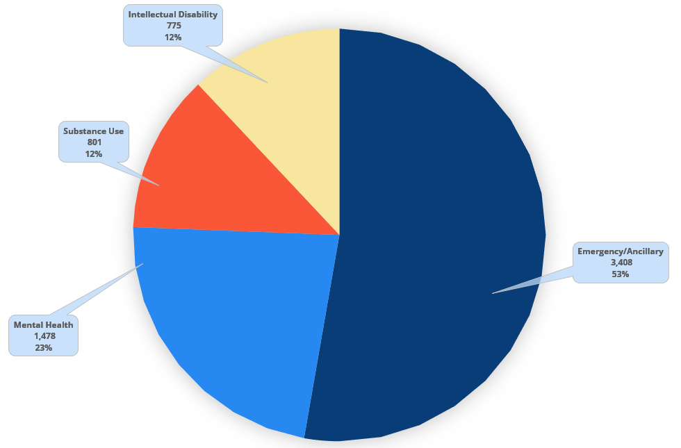
Individuals Served in FY20
Adult DUAL Diagnosis ES
Adult ES Emporia
Adult ID-DD Preadm
Adult Preadm
Adult STAFF Child Dual Diagnosis ES
Adult SU Preadm Bank St
Child 12th Dist CSU Child 6th Dist CSU Preadm
Child Crater Preadm
Child DD Screening
Child Head Start/VPI
Child ID-DD Preadm
Child Preadm
Child SB Preadm
CI CAC
CI ES Calls
CI ES Central
CI Hosp Liaison
CI Same Day Access
*Count is not unduplicated. Individuals receiving more than one service will be counted in each service

Slide 14
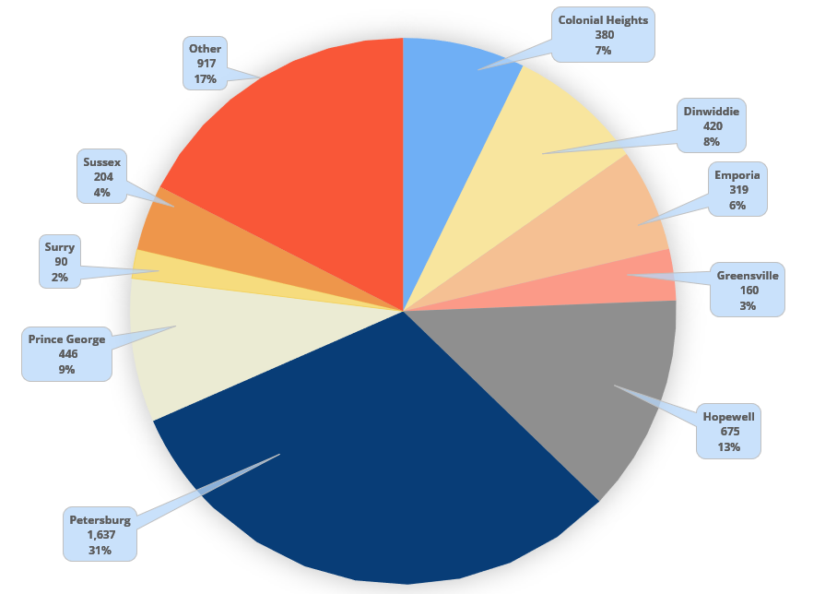
Individuals Served by Locality
Individuals Served by Locality

Slide 15
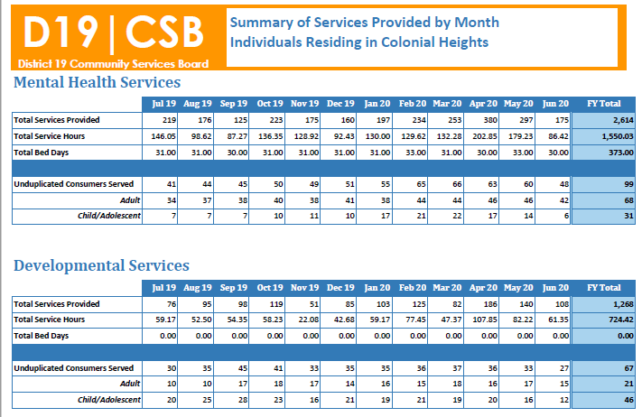

Slide 16
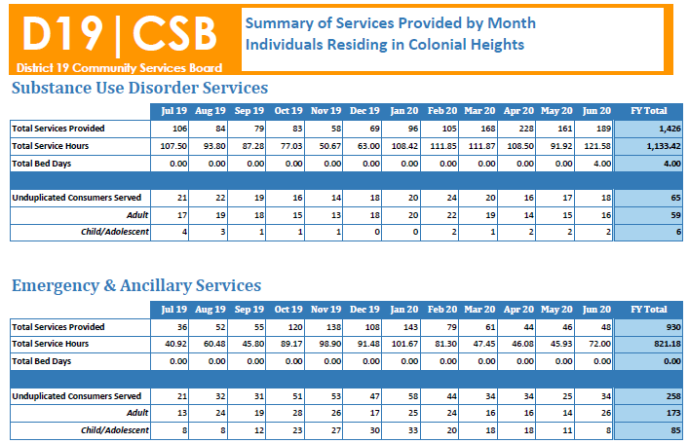

Slide 17
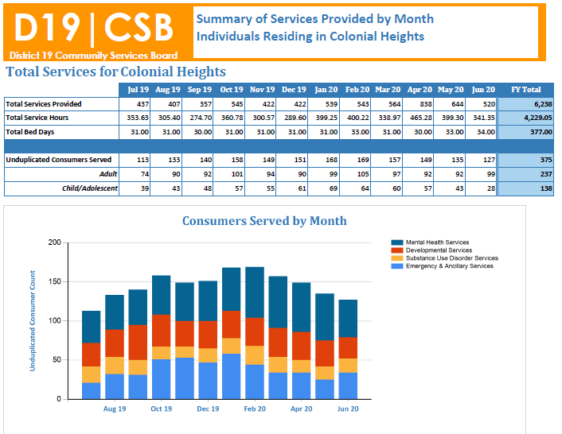

Slide 18




District 19 Funding
District 19 CSB finances its work through a combination of public and private sector funding. Funding comes from federal, state, and local entities. District 19 serves a high volume of individuals that are uninsured. Service fee revenue comes primarily from Medicaid, but also from other sources. District 19 began accepting some commercial insurances for services in February 2019.

Slide 19
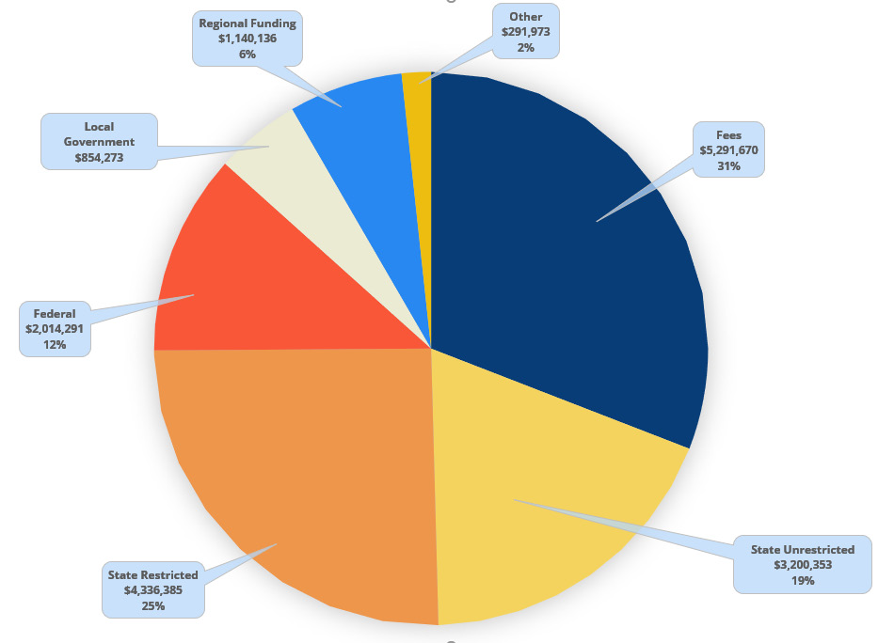
Revenue
Fees
State Funds
Federal Funds
Local Government
Other Agencies
Interest Income
Gain on sale of capital assets
Miscellaneous local
$5,315,210
$7,147,244
$1,677,238
$818,466
$1,028,332
$9,962
-$64,818
$227,555
$16,159,189
Total

Slide 20
Local Funding Match Requirement
Sections 37.2-509 and 37.2-611 of the Code of Virginia establish establishes the minimum local matching funds requirement reciprocally at 10 percent.
*FY21 State fund contribution to District 19: $8,510,923
FY21 local matching funds requirement: $900,243
* State fund contribution is based on current “known” funding allocations. This amount can change throughout the year when the State allocates additional funds for specific purposes.

Slide 21
Local Match Request for FY22
**Level funding
Due to CARES Act Funding and other restricted funding streams due to COVID-19 that are still unknown, District 19 has requested that all nine localities provide the same amount of funding in FY22 as was allocated in FY21.
Local funding requests sent to local officials separately.

Slide 22
New Legislation that impacts your locality: Marcus Alert
What is MARCUS Alert?
Mental health awareness response and community understanding services alert system = Marcus Alert system
Named for Marcus-David Peters who was shot and killed by Richmond police in 2018 in the midst of a behavioral health crisis
Marcus alert is a series of protocols aimed to divert to the behavioral health system or respond with a specialized law enforcement response, including:
1. Protocols to divert from 911 to crisis call center
2. MOUs for law enforcement backup to a crisis response
3. Minimum standards/best practices for law enforcement response

Slide 23
What is the MARCUS Alert seeking to change and/or implement?
Reform governmental responses to Virginians in behavioral health crisis
Implement a set of protocols, procedures, and response teams to ensure that Virginia provides a behavioral health response “no force first” response to a behavioral health crisis

Slide 24
Overall Goals of MARCUS Alert and the build out of Crisis Services in Virginia:
1. To provide Crisis services rooted in a comprehensive crisis system framework with essential elements based on national best practice models;
2. Supports the rights of all Virginians, regardless of area of residence and race/ethnicity to access behavioral health care safely, in a timely fashion, and in the least restrictive environment
3. Decreases Virginia’s reliance on law enforcement as the de facto response to behavioral health crises, and
4. Ensures that Virginians with disabilities receive appropriate accommodations to include a safe, compassionate, trauma-informed response when law enforcement is involved during a behavioral health crisis

Slide 25
Timeline for Marcus Alert Implementation
July 1, 2021: Plan, with diverse stakeholder input, due to general assembly. Will include requirements for protocol development, clarity on what protocols are state-standard vs. individualized, and process for review and approval
December 1, 2021: 5 initial areas covered by all components of Marcus Alert (protocols and response teams) (Please note: D19 was not selected as an initial area to implement MARCUS Alert).
July 1, 2022: all localities covered by Marcus Alert protocols; 5 more areas covered by all components (including response teams)
Response teams built out over following years until statewide coverage of all components

Slide 26
What is D19 doing to prepare for MARCUS Alert?
Taking steps toward readiness
  researching similar geographical areas and multijurisdictional models across the state and country w/ similar initiatives in place
Seeking representation on state group, stay engaged and attend forums, calls for comments, etc.
  D19 was not selected as a representative on the state group but does attend MARCUS Alert listening sessions and will participate in the regional groups
Form local group following release of state requirements (July 1, 2021)
  Group will built on the foundation of the current CIT stakeholders group that meets at least every quarter
  Additional city/county governmental officials, community partners, and others will be invited to join once the guidelines are received.
Focus of first year will be on protocols for diversion from PSAPs (Public Safety Answering Point), protocols to serve as back up to regional mobile crisis, and changes to police presentation when responding
  Will be developed once the group is formed.
During first year, may determine plan for team coverage (mobile crisis vs. community care vs. co-responder)
Will submit plans for approval to implement by July 1, 2022

Slide 27
Long Term Outcomes and Additional information
See more about Crisis Now Model at www.crisisnow.com
Coordinated crisis response between state, regional, and local work at Intercept 0 and Intercept 1 (Sequential Intercept Model)
Increased diversion to the behavioral health system for individuals in crisis, decreased police involvement in behavioral health/developmental disability crisis
Improved safety and better outcomes for individuals experiencing a behavioral health crises at risk of law enforcement involvement
Health centered approach for individuals in behavioral health crisis, whether response is by mobile crisis, community care, or law enforcement/specialized responses

Slide 28
Colonial Heights City Council Meeting
April 13, 2021
Commendations And Presentations:
C. Presentation Of The City Manager's FY2021-2022 Proposed Annual Operating Budget

Slide 29
FY2021-2022 City Manager’s Proposed Budget
Presentation to Council
April 13, 2021

Slide 30
Looking Back- 1 Year Ago
Expected impact of COVID-19 response on remainder of FY20 and planning for FY21.
  Adopt FY21 budget at pre-COVID levels
  Implement and adjust spending controls as revenue situation dictates.
FY21 |  | Scenarios run in April 2020
 | As Adopted | Moderate | Difficult | Severe
Real Estate | 20,919,203 | 20,500,819 | 20,082,435 | 19,664,051
Sales Tax | 8,061,260 | 7,255,134 | 6,852,071 | 6,449,008
Meals Tax | 7,285,359 | 6,556,823 | 5,828,287 | 5,099,751
BPOL | 3,179,917 | 2,464,436 | 2,225,942 | 1,987,448
Personal Property | 3,050,246 | 2,989,241 | 2,897,734 | 2,745,221
Lodging Tax | 1,279,296 | 1,023,437 | 895,507 | 799,560
Total | 43,775,281 | 40,789,890 | 38,781,976 | 36,745,039

Slide 31
Looking Forward- FY21 Projection
 |  | Scenarios run in April 2020 |  |  | As Projected | Projected
 | As Adopted | Moderate | Difficult | Severe | March 2021 | Impact
Real Estate | 20,919,203 | 20,500,819 | 20,082,435 | 19,664,051 | 20,748,911 | Moderate
Sales Tax | 8,061,260 | 7,255,134 | 6,852,071 | 6,449,008 | 8,048,540 | No Impact
Meals Tax | 7,285,359 | 6,556,823 | 5,828,287 | 5,099,751 | 7,018,795 | No Impact
BPOL | 3,179,917 | 2,464,436 | 2,225,942 | 1,987,448 | 2,921,775 | No Impact
Personal Property | 3,050,246 | 2,989,241 | 2,897,734 | 2,745,221 | 3,021,410 | Moderate
Lodging Tax | 1,279,296 | 895,507 | 703,613 | 559,692 | 1,059,616 | Moderate
Total | 43,775,281 | 40,789,890 | 38,781,976 | 36,745,039 | 42,819,047 | Moderate

Slide 32
Looking Forward- FY22 Projection
 | FY21 Budget | FY21 Projected | FY22 Proposed
Real Estate | 20,919,203 | 20,748,911 | 21,052,640
Sales Tax | 8,061,260 | 8,048,540 | 8,119,754
Meals Tax | 7,285,359 | 7,018,795 | 7,274,000
BPOL | 3,179,917 | 2,921,775 | 2,958,755
Personal Property | 3,050,246 | 3,021,410 | 3,323,990
Lodging Tax | 1,279,296 | 1,059,616 | 1,124,765
 | $43,775,281 | $42,819,047 | $43,853,904

Slide 33
General Fund Revenue Trends

Slide 34
General Fund Revenue
FY21-22 Proposed Budget
FY20-21 Adopted Budget
$61,700,077
Notes:
FY22 General Fund Revenue $61,839,700
FY21 General Fund Revenue $61,700,077

Slide 35
General Fund Expenditures
FY21-22 Proposed Budget
$61,839,700
FY20-21 Adopted Budget
$61,700,077

Slide 36
Proposed Budget Highlights
PERSONNEL
Full Year 2.0% COLA Increase for FT Employees ($320,000)
State supported 5% COLA Increase for Constitutional Officers & Staff ($0)
Health Insurance Decrease ($95,000)
Two new FT positions:
  Permit Technician, Planning ($63,000, salary and benefits)
  Staff Assistant, Animal Control ($47,500, salary and benefits)
    upgraded from PT position ($17,500 net cost)
One reduction of FT position
  Digital Resource Specialist, Library ($58,500)
Retains PT ERP position in Finance through implementation ($29,000)
Funds reserved in contingency to address compression ($110,000)
Continues 2% turnover savings for larger departments ($273,000)
Notes:
Cons officer net zero because:
We were already giving 2% assuming no state support, so just had to make up the additional 3% for non-CB employees. The additional revenue from comp board covered this.
2% vacancy savings is $273,000

Slide 37
Proposed Budget Highlights
OPERATING- SERVICES
Increase in IT maintenance charges ($105,000)
Public safety server room cleanup ($11,000)
Training- NeoGOV Leaning Management Module ($16,400)
Increase in Richmond Regional Tourism membership ($20,000 to $30,000)
Property, liability, vehicle and LODA insurance 5% premium increase ($43,000)
Regional Jail decrease
  FY21 Fund balance transfer ($200,000)
  lower expected usage ($68,000)

Slide 38
Proposed Budget Highlights
OPERATING- SERVICES (cont.)
Increase in Chesterfield Shared Services
  Drug Courts ($34,000)
  Community Corrections ($44,800)
Extradition expenditures and recoveries budgeted ($0)
Increased school funding per MOU ($37,630)

Slide 39
Proposed Budget Highlights
EQUIPMENT/ CAPITAL
Six replacement patrol cars and one replacement admin vehicle for Police Department ($282,400)
Van for Community Center & Office on Youth (shared, $40,000)
Polygraph system, Tasers & Bolawraps, Patrol Rifles, speed monitoring system & storage shed for Police Department ($37,300)
Turnout gear, hose replacement, extrication equipment, and nozzles & appliances for Fire Department ($80,000)
Light replacement at Fire Station #2 ($11,500)
Public Safety Building & Community Center HVAC replacements ($64,000)

Slide 40
Proposed Budget Highlights
EQUIPMENT/ CAPITAL (cont.)
Courthouse carpet replacement ($10,600)
Fleet Maintenance storage building ($10,000)
Two zero-turn mowers ($24,000)
Shepherd Stadium wall replacement & chair back seats ($44,000)
Notes:
Zero-turn heavily utilized in general performance of departmental duties. Due to consistent maintenance issues and down-time of the current (2) mowers being used. These mowers are utilized daily from March to November for grass cutting purposes at parks and facilities.; will negatively impact service and increase maintenance without replacement.
Shep Stadium wall: Remove and dispose of approximately 125ft of the failing left field wall. Install new footing with bump outs for columns. New footers to have continuous #5 rebar throughout with anchors turned up every 4ft. Each 4ft rebar upright to have added rebar to top of wall and be grouted solid. All column bump outs to have vertical rebar and also be grouted. Add solid 4” block cap to all new block installed on wall matching existing outfield wall.
40 chair back seats for new field level area at Shepherd Stadium.

Slide 41
Proposed Budget Highlights
EQUIPMENT/ CAPITAL – Water/Sewer
WATER
Insta-valve ($60,000)
Pick-up Truck ($33,000)
SEWER
Pick-up Truck ($32,000)
Pump Replacement – Sherwood Hills pump station ($25,000)
Portable Steam/Power Cleaner ($4,000)

Slide 42
Proposed Budget Highlights: Use of Fund Balance
Fund Balance used for One-Time Equipment/ Capital Needs:
Replace Engine 941 (CIP) $560,000
Replacement Patrol Cars 100,000
Demolition of 218 Highland (CIP) 50,000
Public Safety Building HVAC 48,000
Shepherd Stadium Wall Replacement 35,000
Replacement Police Admin Car* 25,000
Fire Station #2 Lights Replacement 11,500
  TOTAL $829,500
*From forfeiture funds

Slide 43
Proposed Budget Highlights
REVENUE CHANGES
5% Increase in Utility Rates & Restructuring
STRUCTURAL CHANGES
Animal Control as separate budget department
Information Technology Service Fund
  Monthly IT charges to departments ($55 / month / computer)
  IT Replacement Fund
  Outsourced IT charges
General Fund operational transfer to Water & Sewer Fund ($102,000)

Slide 44
Chesterfield Shared Services
Service | FY21 Adopted Budget | FY22 Chesterfield Request | FY22 Proposed Budget | Difference
Child Advocacy Center | $10,000 | $10,000 | $10,000 | $0
Community Corrections | $302,421 | $347,200 | $347,200 | $0
CSA Administration | $60,000 | $53,800 | $53,800 | $0
Circuit Court | $31,508 | $31,600 | $31,600 | $0
Drug Courts | $64,581 | $98,700 | $98,700 | $0
Juvenile Detention Home | $67,500 | $101,967 | $101,967 | $0
Social Services | $400,000 | $420,200 | $400,000 | -$20,200
Radio Shop | $200,000 | $220,700 | $215,702 | -$4,998
Total | $1,136,010 | $1,284,167 | $1,258,969 | -$25,198
City estimates based on anticipated actual expenditures in each service; County request based on County’s proposed budget.

Slide 45
Overview – All Funds

Slide 46
Year to Year Change- General Fund
General Fund Increase $130,000
CIP Transfer (134k Operating, 610 Fund bal.) (260,000)
Transfer to Schools 38,000
Transfer to Water & Sewer 102,000
Incarceration (Net of RRJA and CCJDH) (296,000)
Debt service (2021 Issuance) 143,000
COLA Increases 300,000
New FT Personnel 110,000
Health Insurance Decrease (92,000)
Chesterfield Shared Services 79,000
Other/ Misc 6,000
$130,000
Notes:
GF Incr

Slide 47
Year to Year Change- Other Funds
Recreation Fund Decrease $(9,000)
  CIP (one time use of reserves in FY21)
Capital Projects Increase 1,508,000
  Issuance of $1.7M in debt for projects in FY22.
Notes:
Recreation Fund Decrease $(172,000)
CIP (one time use of reserves in FY20)
Capital Projects Increase 837,176
Large one-time projects funded through assigned fund balances & state assistance
Fund balances
Balance of Hrouda 735,000 (500,000 from Bruce Ave)
Ridge Road 50%/50% 660,706, 330,353 from assigned FB
ARGT V 415,000 (80% from state)

Slide 48
Year to Year Change- Other Funds
Stormwater Decrease (110,000)
No capital for FY22
Utilities Increase 83,000
5% increase in rates did not occur in FY20, so revenue flat
2.0% COLA & General Fund Transfer

Slide 49
Unfunded Requests
General
Remainder of FT position for Economic Development ($30,000)
Salary supplements-General District and Juvenile Courts ($23,000)
Fire Department staff vehicle ($49,000)
Chemical Spreader- Streets ($15,000)
SUV for Office on Youth ($32,500)

Slide 50
Questions

Slide 51
Colonial Heights City Council Meeting
April 13, 2021
Commendations And Presentations:
D. Mayor Kochuba To Provide Update On The Crater Regional Workforce Development Board

Slide 52
Crater Regional Workforce Development
Regional Office Servicing: Colonial Heights, Dinwiddie, Emporia,
Greensville, Hopewell, Petersburg, Prince George, Surry & Sussex
Board of Directors: Chief elected officials from each locality
Mission: Providing assistance for those seeking employment (youth & adults) and businesses looking for employees
Funding Source: Federal funding from the Workforce Innovation & Opportunity Act (WIOA)

Slide 53
Crater Regional Workforce Development
State Oversight: Virginia Community College System
Operating Procedures: An agreement approved by localities
    Prior agreement signed in 1999
    Current agreement signed in 2019
Recent Audit: Identified a payment was made to a non-approved state contractor
    Based on the 1999 agreement localities are responsible for
    any disallowed costs either evenly divided or based on a percentage

Slide 54
Colonial Heights City Council Meeting
April 13, 2021
8. Reading of Manner Addressing Council
ANY MEMBER OF THE PUBLIC addressing the Council shall approach the lectern, give his name and address in an audible tone of voice for the record, AND ADDRESS THE COUNCIL AS A BODY RATHER THAN SPEAK TO ANY MEMBER. Unless further time is granted by the Council, ANY MEMBER OF THE PUBLIC shall address the Council for a maximum of five (5) minutes, regardless of the number of issues he desires to discuss. PROVIDED however, that the main proponent of any application, petition, or plan that is the subject of a public hearing shall be allowed to address the Council initially for a
maximum of ten (10) minutes and later in rebuttal for a maximum of three (3) minutes.

Slide 55
Colonial Heights City Council Meeting
April 13, 2021
Written Petitions and Communications By Members of the Public and Council Members
A. Presentation Of Information By Mr. Cherry On Police Mandate With Regard To Temporary Detention Orders For Suspects While Detained Hospitals Awaiting Transfer

Slide 56
Colonial Heights City Council Meeting
April 13, 2021
Written Petitions and Communications By Members of the Public and Council Members
B. Mr. Cherry To Provide Comments On The Operation Of A Mobile Health Clinic In The City Of Colonial Heights

Slide 57
Colonial Heights City Council Meeting
April 13, 2021
10. Advertised Public Hearings
A. Public Hearing On The Proposed FY2022-FY2026 Capital Improvement Plan

Slide 58
Colonial Heights City Council Meeting
April 13, 2021
10. Advertised Public Hearings
B. AN ORDINANCE 21-FIN-4
(First Reading) To amend the General Fund Budget for the fiscal year beginning July 1, 2020 and ending June 30, 2021, by appropriating $2,458,986, consisting of 1) $941,054 in restricted fund balance from VDOT maintenance funds for pavement preservation projects; 2) $1,500,000 in unassigned fund balance for emergency sewer repairs;

Slide 59
10.B. AN ORDINANCE NO 21-FIN-4 continued…
3) $8,000 in assigned fund balance for the replacement of the HVAC unit on the utilities building; 4) $2,833 in animal shelter donations; 5) $6,399 in restricted fund balance for the purchase of a narcotics canine and the associated supplies; 6) $700 in additional fire program grant funds; and 7) $125,000 from the contingency reserve to be transferred to the emergency response fund for the August flooding event and February ice storms.

Slide 60
10.B. AN ORDINANCE NO 21-FIN-4 continued…
To amend the Emergency Response Fund Budget for the fiscal year beginning July 1, 2020 and ending June 30, 2021, by appropriating $125,000 which is transferred from the general fund for the August flooding event and February ice storms.
To amend the Capital Projects Budget for the fiscal year beginning July 1, 2020 and ending June 30, 2021, by appropriating $1,246,353 consisting of 1) $1,109,604 in state and federal funds for the completion of the Dupuy Avenue Modernization project; and 2) $136,749 in state and federal funds for the completion of the City Bridges Rehabilitation project.

Slide 61
10.B. AN ORDINANCE NO 21-FIN-4 continued…
To amend the Water and Sewer Fund Budget for the fiscal year beginning July 1, 2020 and ending June 30, 2021, by appropriating $1,500,000 which is transferred from the general fund for emergency sewer repairs.

Slide 62
Colonial Heights City Council Meeting
April 13, 2021
11. Hearing of Citizens Generally on Non-Agenda Items

Slide 63
Colonial Heights City Council Meeting
April 13, 2021
Consideration of Uncontested Minutes, Ordinances, Resolutions, and Motions in Accordance with the Consent Agenda
    AN ORDINANCE 21-4
    (Second Reading) Awarding the City Manager a 2% bonus.

Slide 64
Colonial Heights City Council Meeting
April 13, 2021
Consideration of Uncontested Minutes, Ordinances, Resolutions, and Motions in Accordance with the Consent Agenda
    B. AN ORDINANCE 21-FIN-3
    (Second Reading) To amend the General Fund Budget for the fiscal year beginning July 1, 2020 and ending June 30, 2021, by appropriating $45,000 in unassigned fund balance for the purchase of a spreader rack for Public Works.

Slide 65
Colonial Heights City Council Meeting
April 13, 2021
Consideration of Uncontested Minutes, Ordinances, Resolutions, and Motions in Accordance with the Consent Agenda
    C. November 8, 2014 Special Meeting Minutes
    D. April 26, 2016 Special Meeting Minutes
    E. March 9, 2021 Special Meeting Minutes
    F. March 9, 2021 Regular Meeting Minutes

Slide 66
Colonial Heights City Council Meeting
April 13, 2021
Introduction And Consideration Of Ordinances And Resolutions:
None

Slide 67
Colonial Heights City Council Meeting
April 13, 2021
Unfinished Business, Contested Ordinances And Resolutions, And Items Removed From The Consent Agenda
A. AN ORDINANCE NO 21-11 - For Discussion Only
To amend § 286-410.62 of Chapter 286, Zoning, of the Colonial Heights City Code to authorize the operation of mobile food units on a less restrictive basis.

Slide 68
Discussion on Proposed Amendments to
Mobile food Unit Ordinance
Ordinance 21-11

Slide 69
Previous Actions
Mobile Food Units
Ordinance No. 17-25 adopted November 14, 2017, amended farmers’ market code to include up to three mobile food units.
Ordinance No. 18-26 adopted January 8, 2019, permitted mobile food units on private property for limited time periods.

Slide 70
Ordinance Amendment Request
Current Ordinance
Private property may host mobile food units on a limited basis.
New Ordinance
Private property may host mobile food units for regular operation.

Slide 71
ProPosed Ordinance
 | Current Ordinance | Proposed Ordinance
Permit Length | 3 consecutive days | 3 months
Maximum Number of Permits / Year | 4 | No maximum; Easy renewal
Fee per Permit | $50 | $100
Permitted Locations | BB, GB, and religious assembly | All use types except residential
Number of Food Units | Discretion of Zoning Administrator | Discretion of Zoning Administrator
Signage | No allowance | One freestanding sign during operation

Slide 72
Colonial Heights City Council Meeting
April 13, 2021
Reports of Officers and Documents Related Thereto:
    A. City Manager
      1. Update On Request For Proposals Process For City’s Audit Firm

Slide 73
Colonial Heights City Council Meeting
April 13, 2021
Reports of Officers and Documents Related Thereto:
    A. City Manager
      2. Update On Congressional Earmark Funding

Slide 74
Colonial Heights City Council Meeting
April 13, 2021
Reports of Officers and Documents Related Thereto:
    A. City Manager
      3. Trash Collection Update

Slide 75
Colonial Heights City Council Meeting
April 13, 2021
Reports of Officers and Documents Related Thereto:
    A. City Manager
      4. General Activity Report

Slide 76
Dates of Interest
April 2021 | May 2021 | June 2021
April 20th (6:00 pm)- City Council Special Meeting – Council Chambers (Budget Work Session) | May 4th (7:00 pm) – Planning Commission Meeting - Council Chambers | June 1st (7:00 pm) – Planning Commission Meeting - Council Chambers (tentative)
April 27th (6:00 pm) - City Council Special Meetings – Council Chambers (Budget-Related Public Hearings/First Reading of Appropriations Ordinances) | May 11th (7:00 pm) – City Council Regular Meeting–Council Chambers | June 8th (7:00 pm) – City Council Regular Meeting–Council Chambers
 | May 18th (6:00 pm)- City Council Special Meeting – Council Chambers | June 15th (6:00 pm)- City Council Special Meeting – Council Chambers

Slide 77
CITY HOLIDAYS
May – Monday, May 31st, 2021: (Government Offices Closed)
July – Monday, July 5th, 2021: (Government Offices Closed)
CITY ACTIVITIES/EVENTS
Drive-In Movie Night – Friday, April 16th (7:30pm) at Rent Equip: Limited spots available. View more details and register online while spots last at https://secure.rec1.com/VA/colonial-heights-va/catalog (Special Events Tab)
Fort Clifton Festival – Saturday, May 8th-Sunday, May 9th (10:30am-5:00pm both days)

Slide 78
Colonial Heights City Council Meeting
April 13, 2021
Reports of Officers and Documents Related Thereto cont.:
    B. City Attorney

Slide 79
Colonial Heights City Council Meeting
April 13, 2021
Reports of Officers and Documents Related Thereto cont.:
    C. Director of Planning and Community Development
    1. Planning Boards And Commissions Summary

Slide 80
Colonial Heights City Council Meeting
April 13, 2021
Adjournment

Slide 81
Colonial Heights
City Council Regular Meeting
April 13, 2021

